Slide 1
DC- AC CONVERTER-INVERTER

Slide 2
Inverter
Single phase half bridge
Single phase full bridge
Inverter Control
Frequency Control
Voltage Control
Harmonic Control (minimisation)

Slide 3
DC-to-AC converters are known as inverters. The function of an inverter is to change a dc input voltage to a symmetrical ac output voltage of desired magnitude and frequency.
•The output voltage could be fixed or variable at a fixed or variable frequency.
• A variable output voltage can be obtained by varying the input dc voltage and maintaining the gain of the inverter constant.
•For low- and medium-power applications, square-wave or quasi- square-wave voltages may be acceptable; and for high-power applications, low distorted sinusoidal waveforms are required.
•With the availability of high-speed power semiconductor devices, the harmonic contents of output voltage can be minimized or reduced significantly by switching techniques.

Slide 4
Inverters are widely used in industrial applications
Variable-speed ac motor drives, induction heating, standby power supplies, uninterruptible power supplies and also in HVDC (high voltage DC transmission) systems.
The input may be a battery, fuel cell, solar cell, or other dc source.

Slide 5
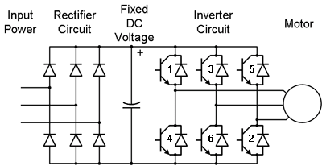
Induction Motor speed control- Application of inverter
a.c. (freq f1) d.c. a.c. (freq f2)
rectifier
inverter

Slide 6
High Voltage DC Transmission System: Application of inverter
a.c. (freq f1) d.c. a.c. (freq f2)
rectifier
inverter

Slide 7
Inverters can be broadly classified into two types:
(I) Single-phase Inverters
(2) Three-phase Inverters
•Each type can use controlled turn-on and turn-off devices (e.g., BJTs, MOSFETs, IGBTs, GTOs) or forced-commutated thyristors depending on applications.
•These inverters generally use PWM control signals for producing an ac output voltage. An inverter is called a voltage- Source inverter (VSI) if the input voltage remains constant, a current-Source inverter ( CSI) if the input current is maintained constant, and a variable dc linked inverter if the input voltage is controllable.

Slide 8
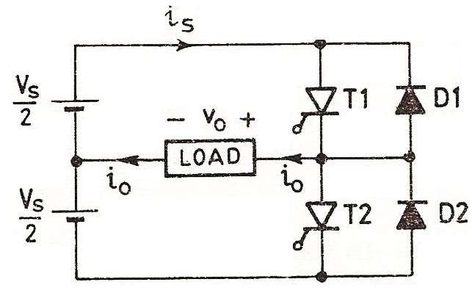
Single Phase Half-Bridge Inverter with R-load

Slide 9
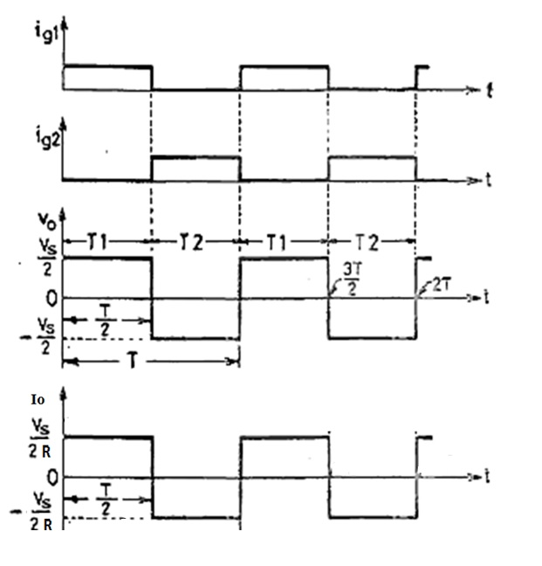
Single Phase Half-Bridge Inverter with R-load-Waveforms

Slide 10
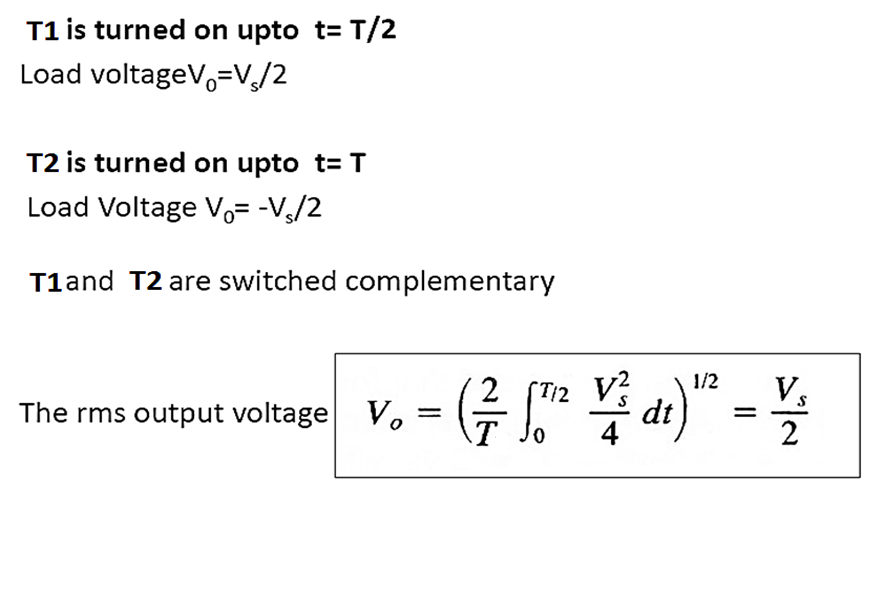
Single Phase Half-Bridge Inverter with R-load-
Modes of operation

Slide 11
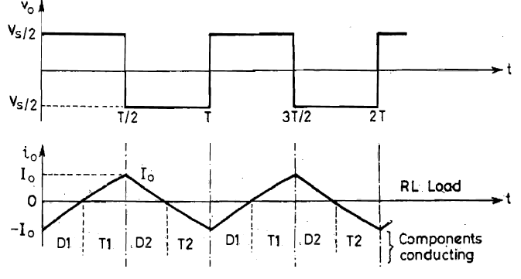
Single-phase half-bridge inverter –RL load

Slide 12
Single Phase Half-Bridge Inverter with RL load-
Modes of operation

Slide 13
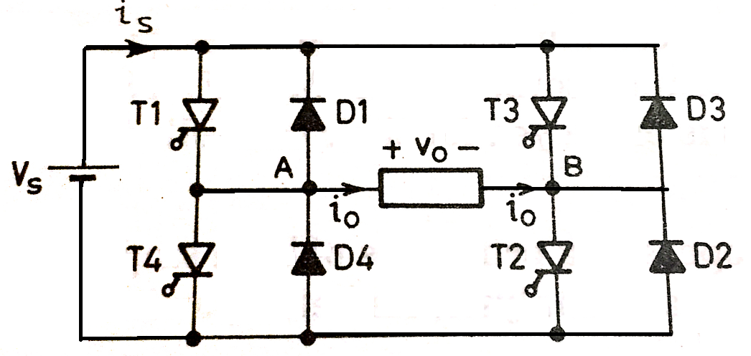
Single Phase Full-Bridge Inverter with R-load

Slide 14
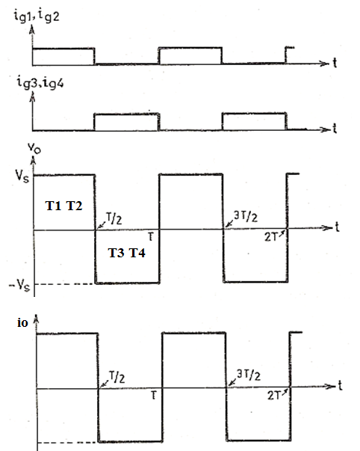
Single Phase Full-Bridge Inverter with R-load
At t=T/2
T1 and T2 are ON then Vo= Vs
At t=T
T3 and T4 are ON then Vo=-Vs
The rms output voltage

Slide 15
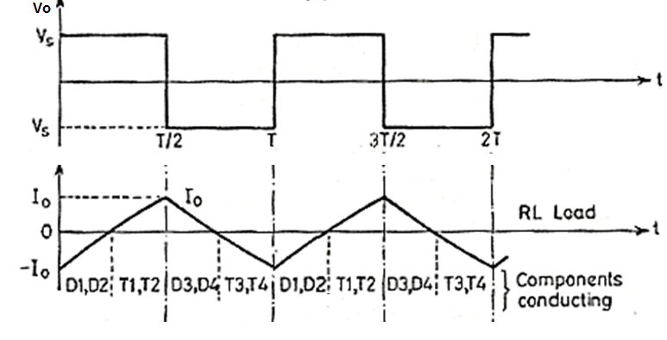
Single Phase Full-Bridge Inverter with RL load

Slide 16
Single Phase Full-Bridge Inverter with RL load
In the waveform of io, Before t = 0, thyristors T3,T4 are conducting and load current io is flowing from B to A, i.e . in the re versed direction, This current is shown as - Io at t = 0.
After T3, T4 are turned off at t = 0, current i o cannot change its direction immediately because of the nature of load. As a result, diodes D1, D2 start conducting after t = 0 and allow io to flow against the supply voltage Vs . As soon as D1, D2 begin to conduct, load is subjected to Vs as shown.
Though T1, T2 are gated at t = 0, these SCRs will not turn on as these are reverse biased by voltage drops across diodes D1 and D2.
When load current through D1, D2 falls to zero, T1 and T2 become forward biased by source voltage VS , T1 and T2 therefore get turned on as these are gated for a period T /2 sec .
Now load current io flows in the positive direction from A to B .
At t = T/ 2 ; T1, T2 are turned off by forced commutation and as load current cannot reverse immediately, diodes D3, D4 come into conduction to allow the flow of current io after T/ 2.
Thyristors T3, T4, though gated, will not turn on as these are reverse biased by the voltage
drop in diodes D3, D4. When current in diodes D3, D4 drops to zero; T3, T4 are turned on
as these are already gated.

Slide 17
Fourier Analysis Of Single-phase Inverter Output Voltage
Output Voltage waves can be resolved into Fourier series equation as follows:
Single-phase half-bridge inverter
Single-phase Full-bridge inverter
n is the order of the harmonic and $ω$ = 2$π$f is the frequency of the output voltage in rad/s

Slide 21
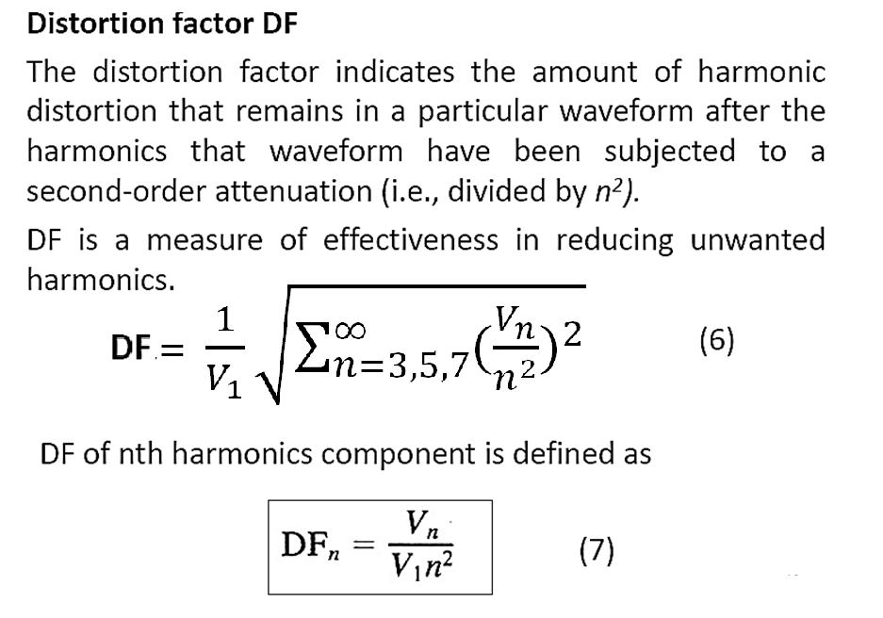

Slide 23
Inverter Control Techniques
Control Techniques (frequency, voltage and harmonics)
Frequency Control
Determined by frequency of fundamental switching pattern
Voltage Control (consequential harmonics)
Vary d.c. input voltage
Quasi-square
Notching
Pulse Width Modulation (PWM) – variable width notching

Slide 24
Quasi-Square
E
High AC voltage (r.m.s.)
E = fixed dc input voltage to inverter
Significant Low Frequency Harmonic Content !!
E
Low AC voltage (r.m.s.)
Voltage control by varying width of +/- pulse

Slide 25
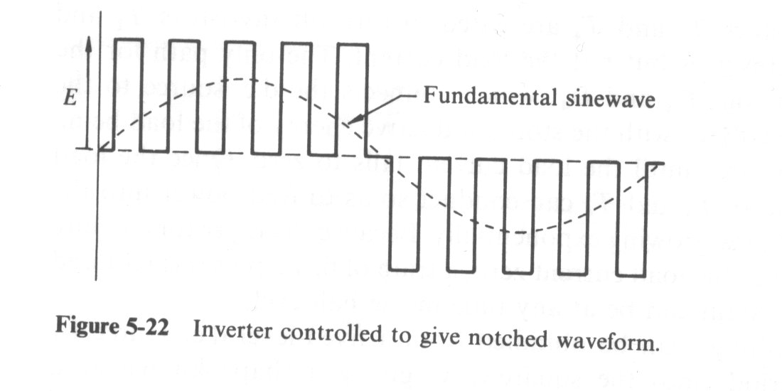
Notching
Can be used for voltage control !
Still has harmonic issues

Slide 26
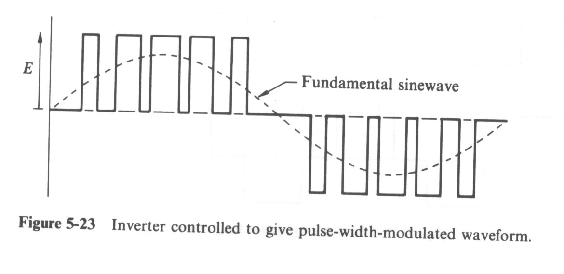
PWM
Minimise Harmonics
Voltage and Frequency Control

Slide 27
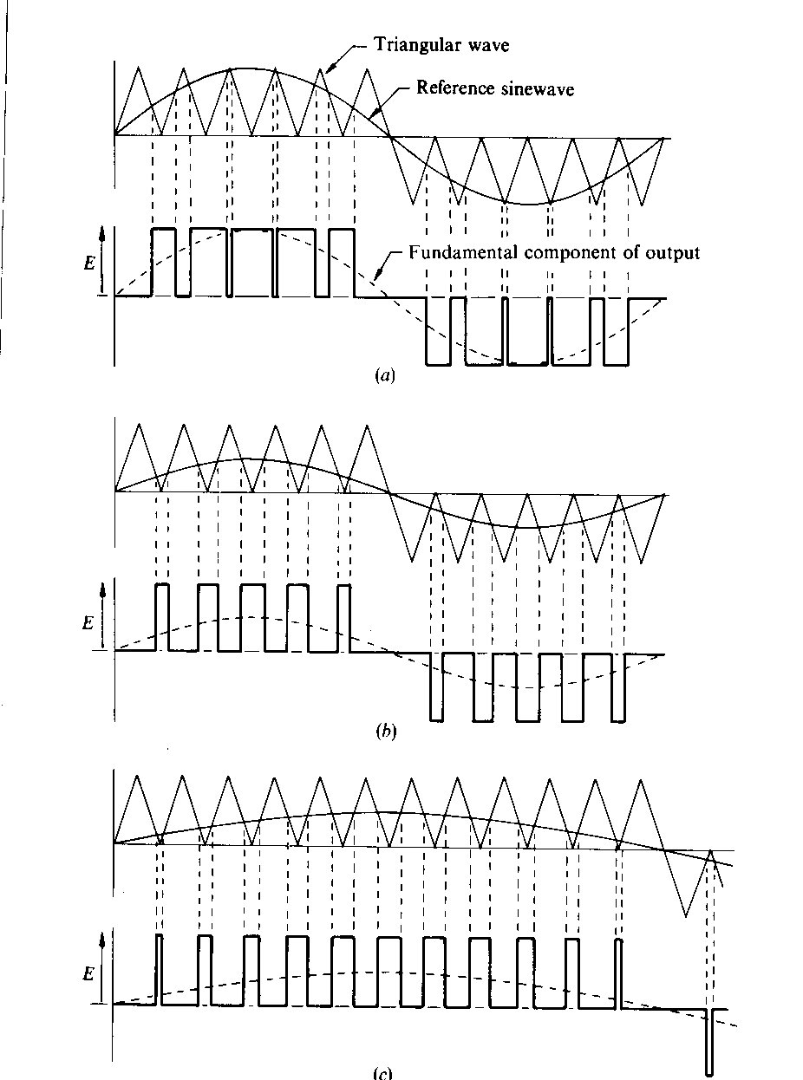
Application of PWM
Reduce Voltage
Frequency Unchanged
Voltage Unchanged
Reduce Frequency

